Slide 1
DenseNet

Slide 2
DenseNet
DenseNet - Densely Connected Convolutional Neural Networks
Popular variants
Densenet121 (input image size – 224 x 224 x 3)
Densenet201
Why DenseNet?
The problems arise with CNNs when they go deeper. This is because the path for information from the input layer until the output layer (and for the gradient in the opposite direction) becomes so big, that they can get vanished before reaching the other side.
DenseNets simplify the connectivity pattern between layers by ensuring maximum information (and gradient) flow. To do it, they simply connect every layer directly with each other.

Slide 3
What problems Densenet solve ?
DenseNets require fewer parameters than an equivalent traditional CNN, as there is no need to learn redundant feature maps.
Furthermore, some variations of ResNets have proven that many layers are barely contributing and can be dropped. In fact, the number of parameters of ResNets are big because every layer has its weights to learn. Instead, DenseNets layers are very narrow (e.g. 12 filters), and they just add a small set of new feature-maps.
Another problem with very deep networks was the problems to train, because of the mentioned flow of information and gradients. DenseNets solve this issue since each layer has direct access to the gradients from the loss function and the original input image.

Slide 4
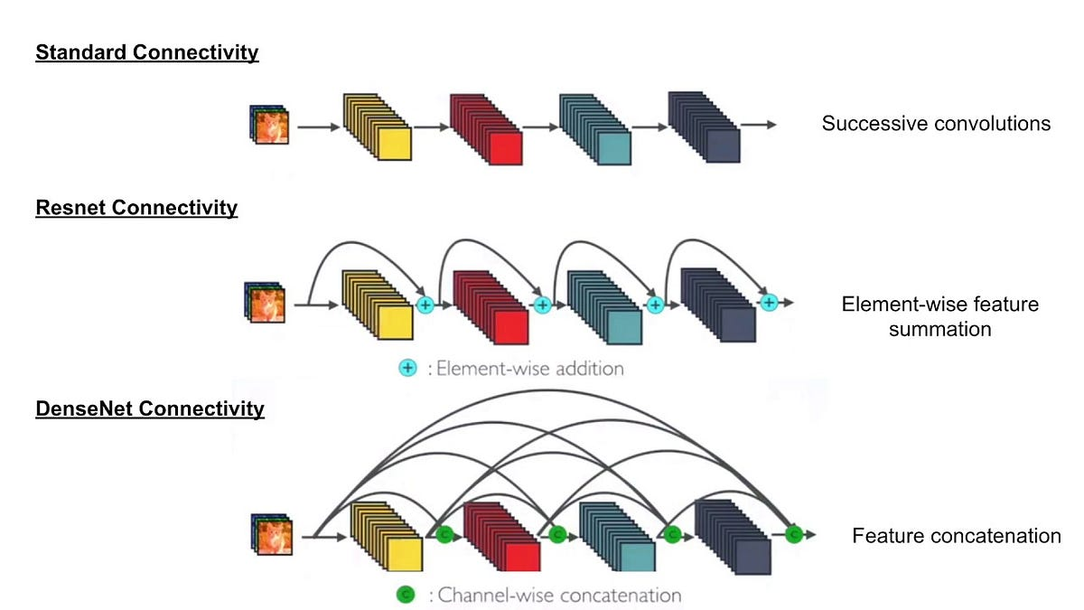
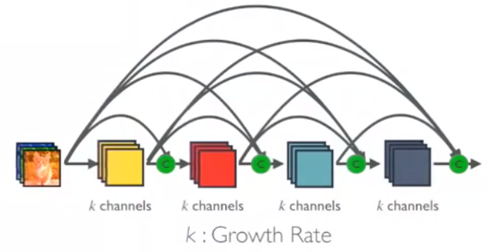
DenseNet vs Resnet
As seen in image for standard CNN, the input image gets through multiple convolutional layers and only in final convolutional
In ResNet CNNs, identity mapping is proposed to promote gradient propogation. Elementwise addition is used. Here the information is passed from one resnet module/block to another block.
In DenseNet, each layer obtains additional inputs from all preceding layers and passes on its own feature-maps to all subsequent layers. Concatenation is used. Each layers is receiving a collective knowledge from all preceding layers.
Since each layer receives feature maps from all preceding layers, network can be thinner and compact, i.e. number of channels can be fewer. The growth rate k is the additional number of channels for each layer.

Slide 5
DenseNet Architecture
To facilitate both down-sampling in the architecture and feature concatenation - the authors divided the network into multiple densely connected Dense blocks and Transition blocks.
Dense block
Inside the dense blocks, no downsampling is done. Thus the feature map size remains the same ensuring feature concatenation
Different no of convolutional layers in each dense block based on DenseNet model variant (121/201)
Each convolution layer in dense block follows BN + Relu + Conv
Growth rate ( k ) - How much information to add by each layer. For example k=3 indicates every layer can add only 3 feature maps to existing feature maps
Transition block
The Convolution + Pooling operations outside the dense blocks can perform the downsampling operation.

Slide 6
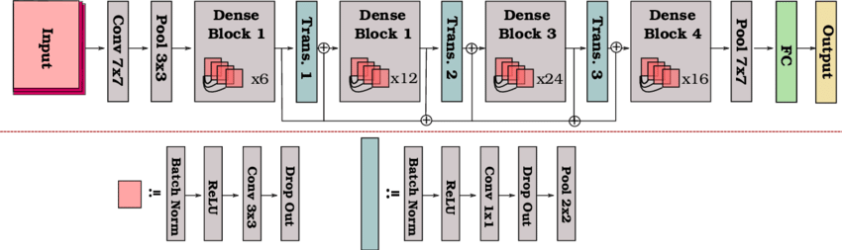
DenseNet 121 Architecture

Slide 7
DenseNet
In Dense blocks to reduce the model complexity and size, 1×1 Conv is done before 3×3 Conv.
DenseNet-BC (Further Compression)
If a dense block contains m feature-maps, The transition layer generate θm output feature maps, where 0<_x0012_θ≤1 is referred to as the compression factor.
When θ_x0012_=1, the number of feature-maps across transition layers remains unchanged. DenseNet with _x0012_θ<1 is referred as DenseNet-C, and θ=0.5 in the experiment.
When both the bottleneck and transition layers with _x0012_ θ<1 are used, the model is referred as DenseNet-BC.
Finally, DenseNets with/without B/C and with different L layers and k growth rate are trained.

Slide 8
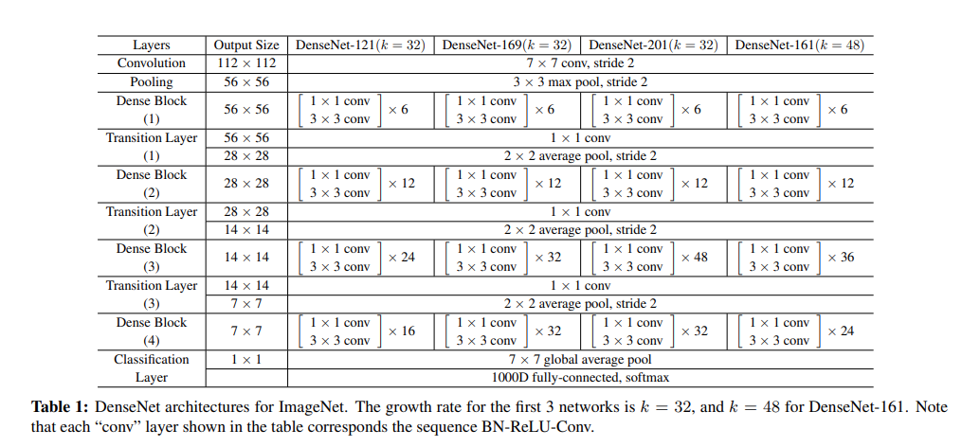
DenseNet Types

Slide 9
Advantages
Solves vanishing gradient by improving gradient flow during training.
Densenet final classifier uses more diversified features (featuremaps of all layers retaining all types of information (simple to complex))
Stengthens feature propogation - features learnt by one layer are directly accessible by another layer via concatenation
Feature reuse - layer4 doesn't have to learn feautres already learnt by layer1
Reduced number of parameters compared to resnet

Slide 10
Disadvantages
Increased computational cost: DenseNet can be slower and more computationally expensive to train and run compared to other architectures.
Memory-intensive: DenseNet may require more memory to store intermediate feature maps, which can limit the size of the images that can be processed and make it less practical for use on certain devices.
Over-reliance on earlier layers: Dense connections may result in limited capacity to learn more complex features in later layers, which may impact its ability to learn certain types of features.

Slide 11
References
- S
Densely Connected Convolutional Networks
Review: DenseNet — Dense Convolutional Network (Image Classification)
Understanding and visualizing DenseNets
DenseNet Architecture Explained with PyTorch
Implement DenseNet in PyTorch

